Slide 1

Level: Advanced
Game Development with Unity
Omid Saadat

Slide 2
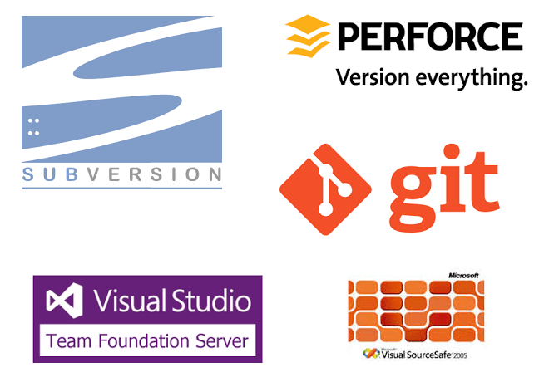
Pick a VCS first
What is a Version Controller?
Which one should I pick? (Hint: Git)

Slide 3

Using Git with Unity
CLI
Unity .gitignore
Git LFS
Want to go Online?
  Public: GitHub
  Private: GitLab

Slide 4
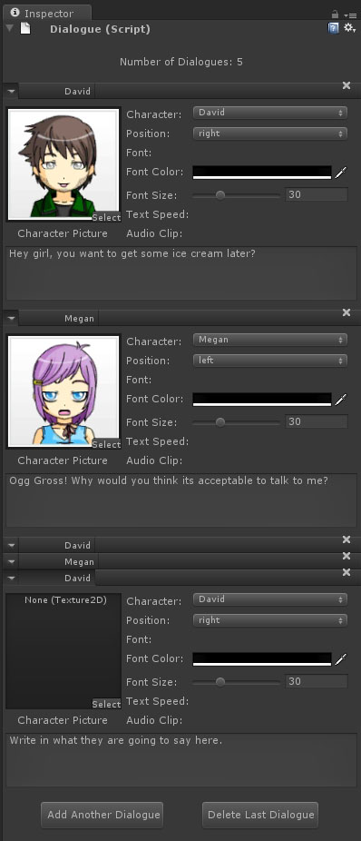
Customizing Unity
Property Drawer
Custom Inspector
Custom Window

Slide 5
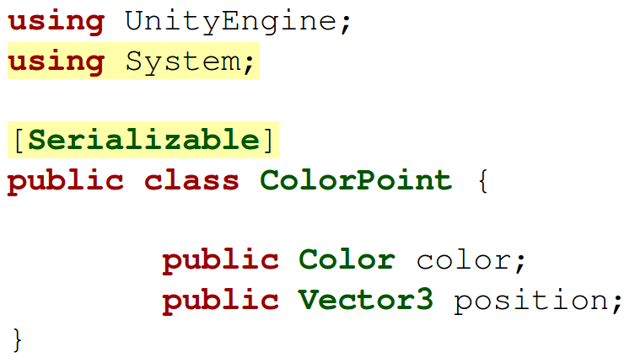
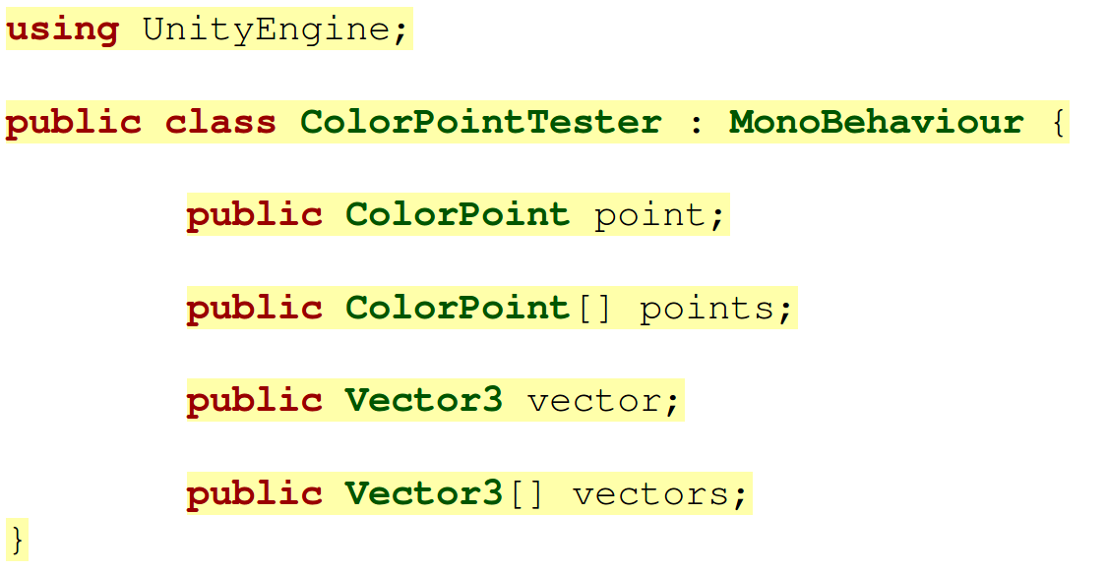
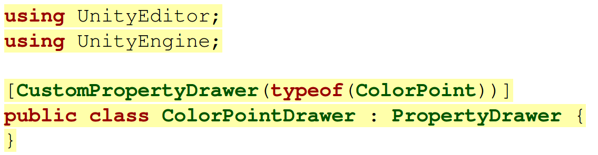
Property Drawer
Customize a drawer for your class

Slide 6
Property Drawer
Your class must be serialized.
Every where your property drawer will replace the default one.
Catlikecoding.com

